Slide 1
FITPULSE ANALYTICS
ML Pipeline — Preprocessing & Pattern Extraction
PRESENTED BY:
SATINDRA KUMAR B S
FITNESS ML ANALYTICS PIPELINE
STREAMLIT • PYTHON • PANDAS • SCIKIT-LEARN • TSFRESH • PROPHET

Slide 2
AGENDA :
Project Overview & Problem Statement
Preprocessing Section — Objectives
Dataset Description
Platform Walkthrough — Upload & Preprocessing
Pattern Extraction — 5-File Detection & Loading
TSFresh Feature Extraction (ML-1)
Prophet Forecasting — HR, Steps & Sleep (ML-2)
Clustering — KMeans, DBSCAN, PCA, t-SNE (ML-3)
Elbow Curve, Cluster Profiles & Pipeline Summary
Technology Stack

Slide 3
Problem Statement:
Fitness data is vast, multi-source, and riddled with quality issues that hinder meaningful analysis.
Massive Volume: 36,500 rows across 16 columns — manual inspection is not feasible.
Missing Data: 21,951 missing cells across 5 key columns (Hours Slept, Water Intake, Active Minutes, Heart Rate, Workout Type).
Mixed Data Types: Numeric, categorical, and datetime fields require different treatment strategies.
No Standardisation: Raw exports from fitness devices need consistent formatting before analysis.
Bias Risk: Unaddressed nulls lead to skewed distributions and unreliable downstream ML results.

Slide 4
Preprocessing — Objectives:
Build an end-to-end interactive preprocessing pipeline for raw fitness CSVs.
Detect and visualise missing values across all dataset columns.
Apply intelligent interpolation & fill strategies to handle nulls without data loss.
Generate a clean, downloadable CSV ready for downstream ML.
Perform Exploratory Data Analysis (EDA) to reveal distribution patterns and outliers.
Deliver a polished Streamlit web application as the interactive deliverable.

Slide 5
Dataset Description:
Dataset: Fitness & Health Tracking Dataset (synthetic Fitbit-style CSV)
Size: 36,500 rows × 16 columns
Users: 100 unique user profiles tracked over 365 days
Key Features: User ID, Date, Age, Gender, Height, Weight, Steps Taken, Calories Burned, Hours Slept, Water Intake, Active Minutes, Heart Rate, Workout Type, Mood, Stress Level
Missing Cells: 21,951 across 5 columns — Hours Slept (3,659), Water Intake (5,401), Active Minutes (1,867), Heart Rate (1,832), Workout Type (9,192)
Source Format: Single CSV — 3.9 MB, UTF-8 encoded

Slide 6
Platform Walkthrough — Preprocessing
Step 1 — Upload Dataset
The user uploads a fitness CSV file. The platform auto-detects the file, validates format, and loads 36,500 rows × 16 columns instantly.
Supports drag-and-drop or file browse (up to 200 MB)
Raw data preview shown immediately after load (first 10 rows)
Row and column count confirmed with success alert

Slide 7
Missing Values Analysis:
Step 2 — Null Detection & Visualisation
Total Rows: 36,500 | Columns: 16 | Missing Cells: 21,951
Hours Slept: 3,659 nulls
Water Intake: 5,401 nulls
Active Minutes: 1,867 nulls
Heart Rate (bpm): 1,832 nulls
Workout Type: 9,192 nulls
Interactive bar chart rendered for all missing columns. Zero missing on non-null columns confirmed.

Slide 8
Data Cleaning & Preprocessing:
Step 3 — Interpolation & Fill Strategy
Numeric Columns: Linear interpolation applied via df.interpolate() — fills gaps without distorting distribution.
Categorical Columns: Filled with "Unknown" placeholder — preserves row integrity and prevents row loss.
Result: Zero missing values in the cleaned dataset — confirmed post-clean.
Output: Clean CSV downloadable for ML pipeline via st.download_button().
EDA histograms with KDE overlay rendered for all numeric columns in pairwise 2-column layout.

Slide 9
Pattern Extraction — File Detection:
Step 1 & 2 — Upload & Auto-Detect 5 Fitbit CSVs
Daily Activity: Detected by TotalSteps, Calories, VeryActiveMinutes columns
Hourly Steps: Detected by StepTotal column
Hourly Intensities: Detected by TotalIntensity, AverageIntensity columns
Minute Sleep: Detected by logId, value, date columns
Heart Rate: Detected by Value, Time columns
Each file assigned a Found ✓ or Missing badge. All 5 required before the pipeline activates.

Slide 10
Data Loading & Master DataFrame:
Step 3 — Parse, Merge & Normalise
All 5 CSVs parsed and merged into a single master DataFrame per user per day.
Heart Rate: Aggregated to daily average BPM using groupby(Id, Date).mean()
Sleep: Minute-level records counted per day → TotalSleepMinutes feature
Null Check: Per-dataset null count displayed in 5 dashboard cards with row counts
Time Normalisation: HR resampled seconds → 1-minute intervals; 100% exact 1-hour steps for hourly data
Master DataFrame: Downloadable as fitpulse_master.csv for downstream use

Slide 11
TSFresh Feature Extraction — ML-1:
Extracts statistical features from Heart Rate time-series per user
Heart Rate CSV parsed to (id, time, value) triplets; datetime and numeric types enforced.
extract_features(): MinimalFCParameters applied — extracts ~11 statistical features per user (mean, std, min, max, etc.)
Output: Features DataFrame of shape (Users × Features) — typically 14 users × 11 features
Normalisation: MinMaxScaler applied to produce 0–1 range for heatmap visualisation
Heatmap: YlOrRd sns.heatmap rendered — rows = users, columns = feature index
Completion: tsfresh_done session flag set; TSFresh step unlocks Prophet stage

Slide 12
Prophet Forecasting — ML-2:
30-day forecasting for Heart Rate, Steps & Sleep
Heart Rate Forecast: Daily average BPM from HR CSV → 30-day ahead forecast, 90% CI, weekly seasonality
Steps Forecast: Daily TotalSteps from Activity CSV → 30-day ahead, 80% CI, changepoint_prior=0.1
Sleep Forecast: Daily sleep minute count from minuteSleep CSV → 30-day ahead, 80% CI
Model Config: mcmc_samples=0 for speed; last 60 days used as training window
Forecast start dashed line plotted. Actual scatter + trend line + confidence band rendered per model.
Output: 3 Prophet charts; prophet_done flag set; Clustering stage unlocked

Slide 13
Clustering & Dimensionality Reduction — ML-3:
KMeans · DBSCAN · PCA · t-SNE on Daily Activity features
Feature Columns: TotalSteps, Calories, VeryActiveMinutes, FairlyActiveMinutes, LightlyActiveMinutes, SedentaryMinutes
Preprocessing: User-level mean aggregation → StandardScaler normalisation
PCA: 2 principal components extracted for 2D scatter visualisation
KMeans: k configurable (2–9) via sidebar slider; n_init=10, random_state=42
DBSCAN: eps configurable (0.5–5.0) via sidebar; min_samples=2; noise points shown in grey
t-SNE: 2D embedding with KMeans labels coloured; perplexity auto-scaled to user count

Slide 14
Elbow Curve & Cluster Profiles — ML-6 & ML-7:
Optimal K selection + User behaviour profiling
Elbow Curve: Inertia computed for K = 2 to 9; plotted to find optimal cluster count
Cluster Profiles Table: Mean feature values per KMeans cluster displayed as a DataFrame
Bar Chart: TotalSteps, Calories, VeryActiveMinutes, SedentaryMinutes compared across clusters
Interpretation Cards: Each cluster labelled as 🏃 Highly Active (>10k steps), 🚶 Moderate (5–10k), or 🛋️ Sedentary (<5k)
Pipeline Summary: Log-box showing dataset, TSFresh feature count, 3× Prophet models, KMeans distribution, DBSCAN noise %, screenshots list

Slide 15
Key Results & Findings:
Preprocessing: 36,500 rows × 16 columns loaded; 21,951 nulls resolved via interpolation + Unknown fill. Zero residual nulls.
5-File Merge: Daily Activity, Steps, Intensities, Sleep, Heart Rate merged into one master DataFrame.
TSFresh: 11 statistical HR features extracted per user; normalised heatmap visualised.
Prophet: 3 forecasts completed — HR (90% CI), Steps (80% CI), Sleep (80% CI) — all 30 days ahead.
Clustering: KMeans + DBSCAN on 6 activity features; PCA and t-SNE projections rendered.
Platform Live: Fully interactive Streamlit app with Preprocessing + Pattern Extraction sections.

Slide 16
Technology Stack:
Frontend / UI: Streamlit — interactive two-section web app with dark-theme CSS, session state, and sidebar controls.
Data Processing: Pandas & NumPy — loading, interpolation, merging, groupby aggregation.
Visualisation: Matplotlib & Seaborn — KDE histograms, missing-value charts, heatmaps, scatter plots, bar charts.
Feature Engineering: TSFresh (MinimalFCParameters) — statistical features from HR time-series.
Forecasting: Prophet (Meta) — weekly seasonality, CI bands, multi-metric 30-day forecasts.
ML / Clustering: Scikit-Learn — KMeans, DBSCAN, PCA, t-SNE, StandardScaler, MinMaxScaler.

Slide 17
Pipeline Flowchart — End-to-End:
🔧 MILESTONE 1 — PREPROCESSING
🤖 MILESTONE 2 — PATTERN EXTRACTION
① Upload CSV
⑥ Load 5 Fitbit CSVs
36,500 rows × 16 cols loaded
Auto-detect by column signature
↓
↓
② Null Detection
⑦ TSFresh (ML-1)
21,951 missing cells visualised
11 HR features per user → heatmap
↓
↓
③ Interpolate & Fill
⑧ Prophet HR (ML-2)
Numeric → interpolate, Cat → Unknown
30-day BPM forecast, 90% CI
↓
↓
④ EDA Histograms
⑨ KMeans + DBSCAN
KDE plots all numeric columns
PCA + t-SNE scatter, k configurable
↓
↓
⑤ Download Clean CSV
⑩ Steps & Sleep Forecast
Zero nulls, ready for ML
Prophet 80% CI, multi-series

Slide 18
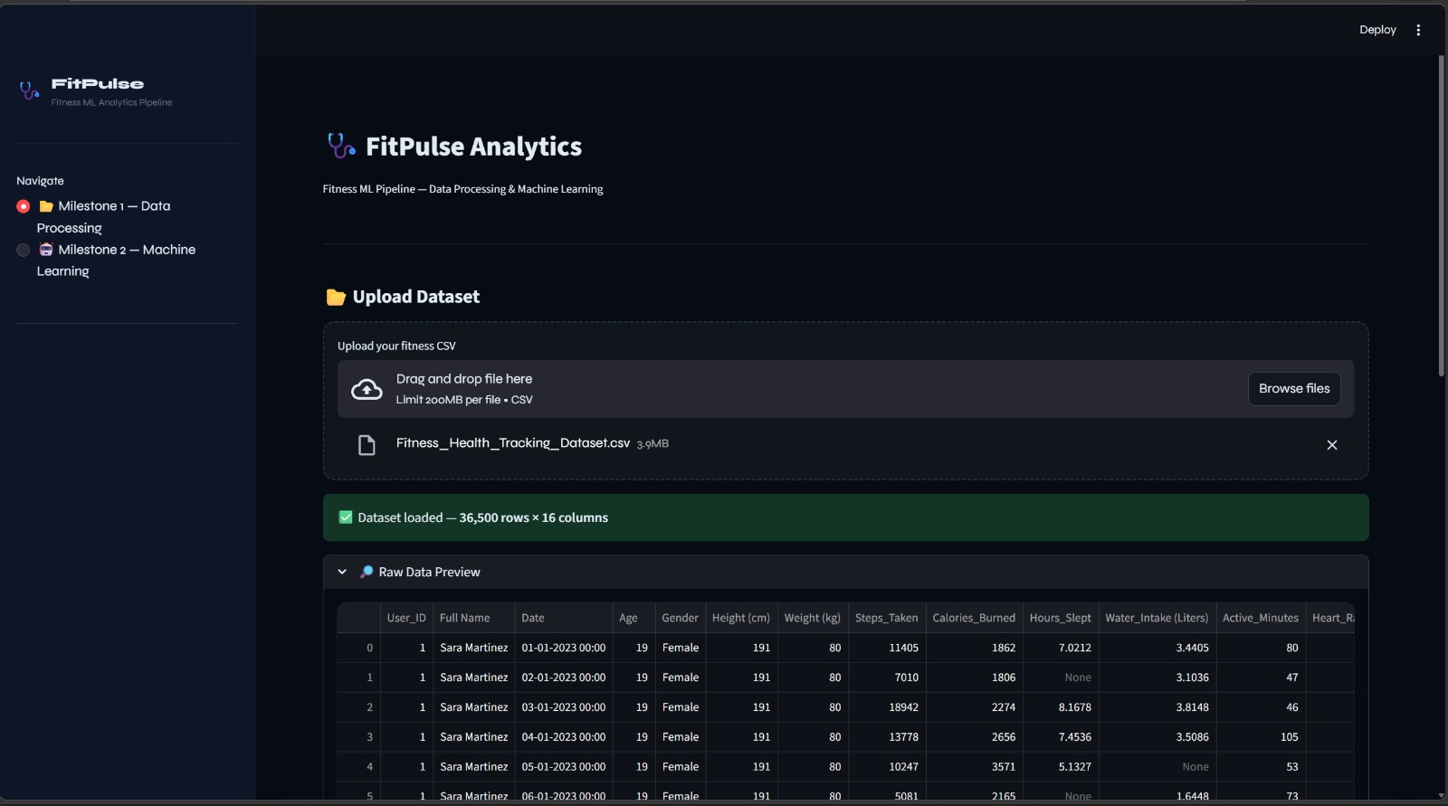
Preprocessing - Result:

Slide 19
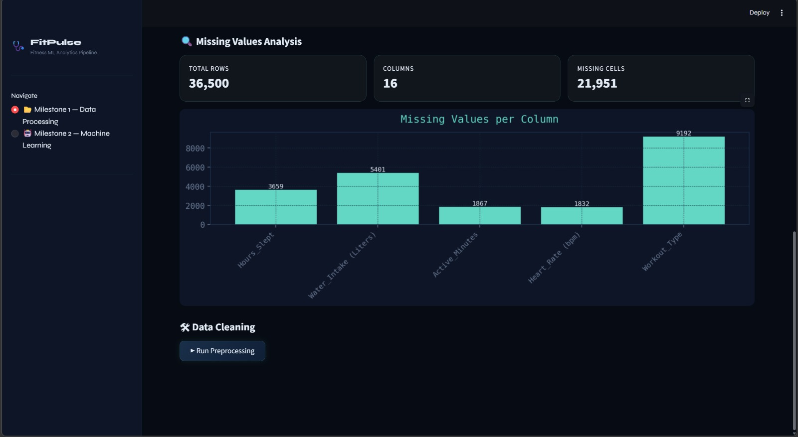
Preprocessing - Result:

Slide 20
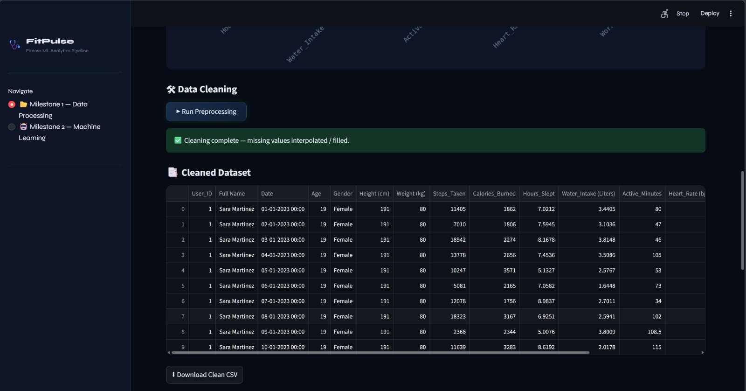
Preprocessing - Result:

Slide 21
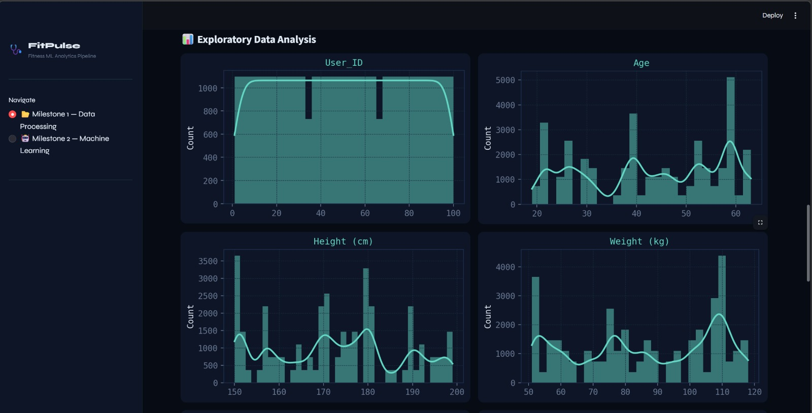
Preprocessing - Result:

Slide 22
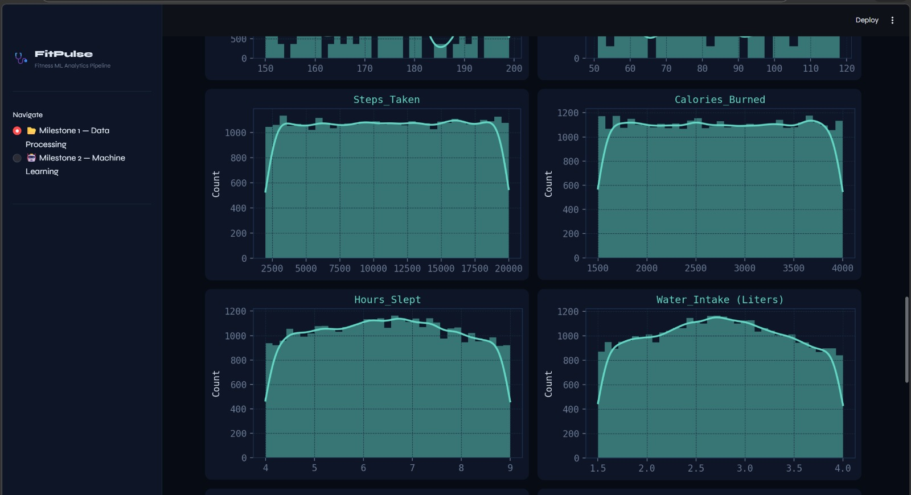
Preprocessing - Result:

Slide 23
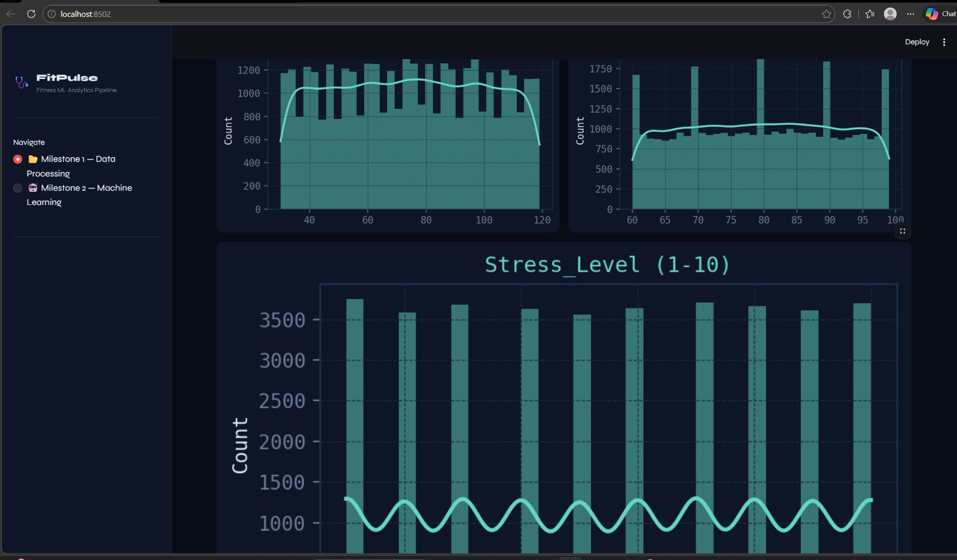
Preprocessing - Result:

Slide 24
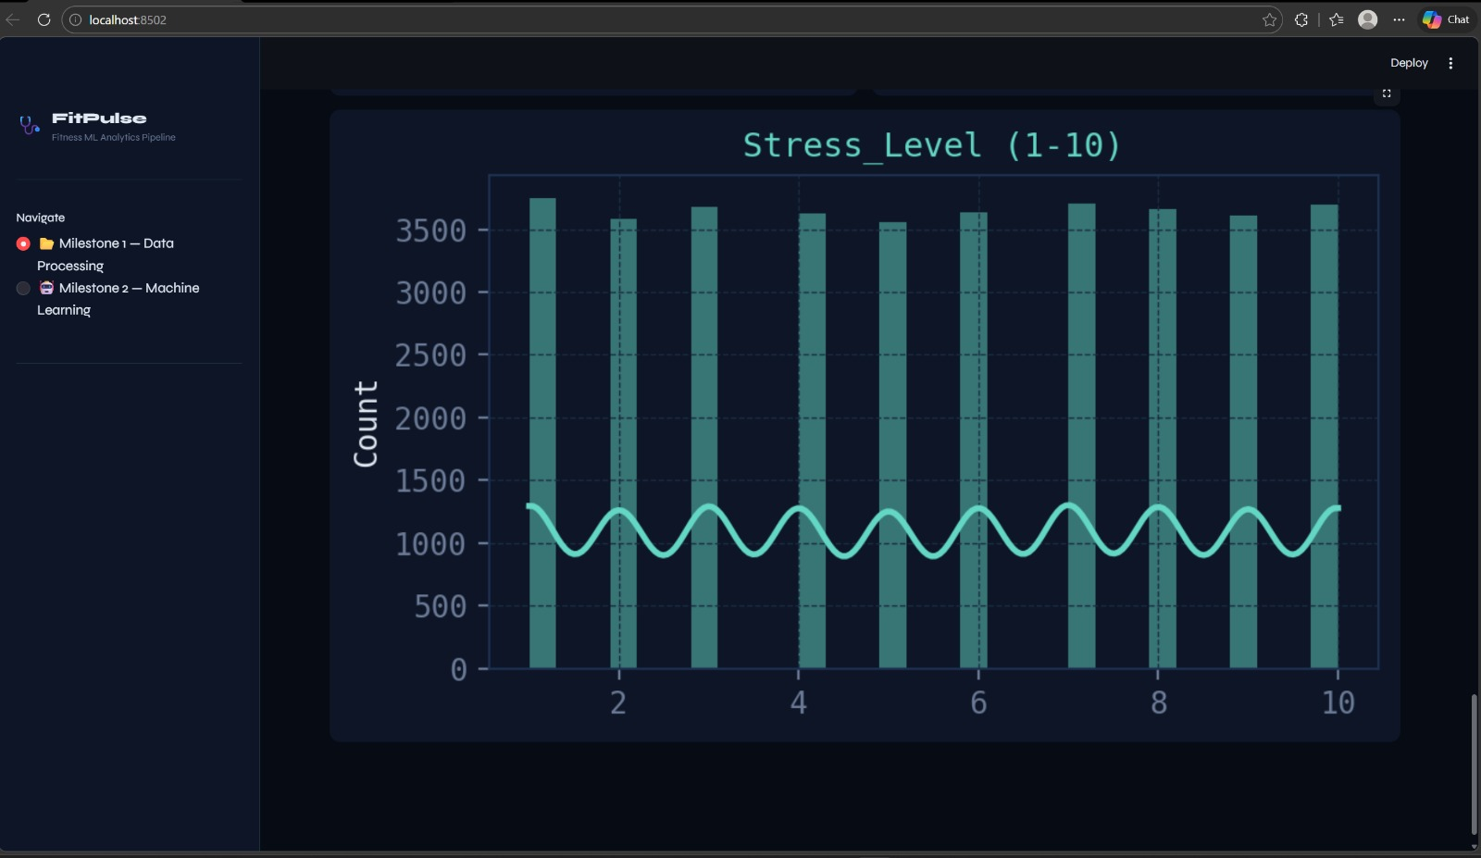
Preprocessing - Result:

Slide 25
Preprocessing - Result:

Slide 26
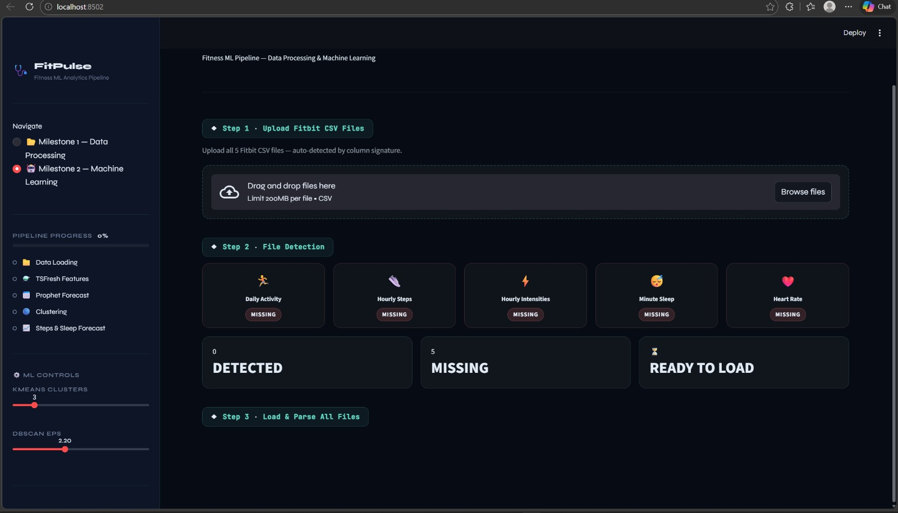
Pattern Extraction - Result:

Slide 27
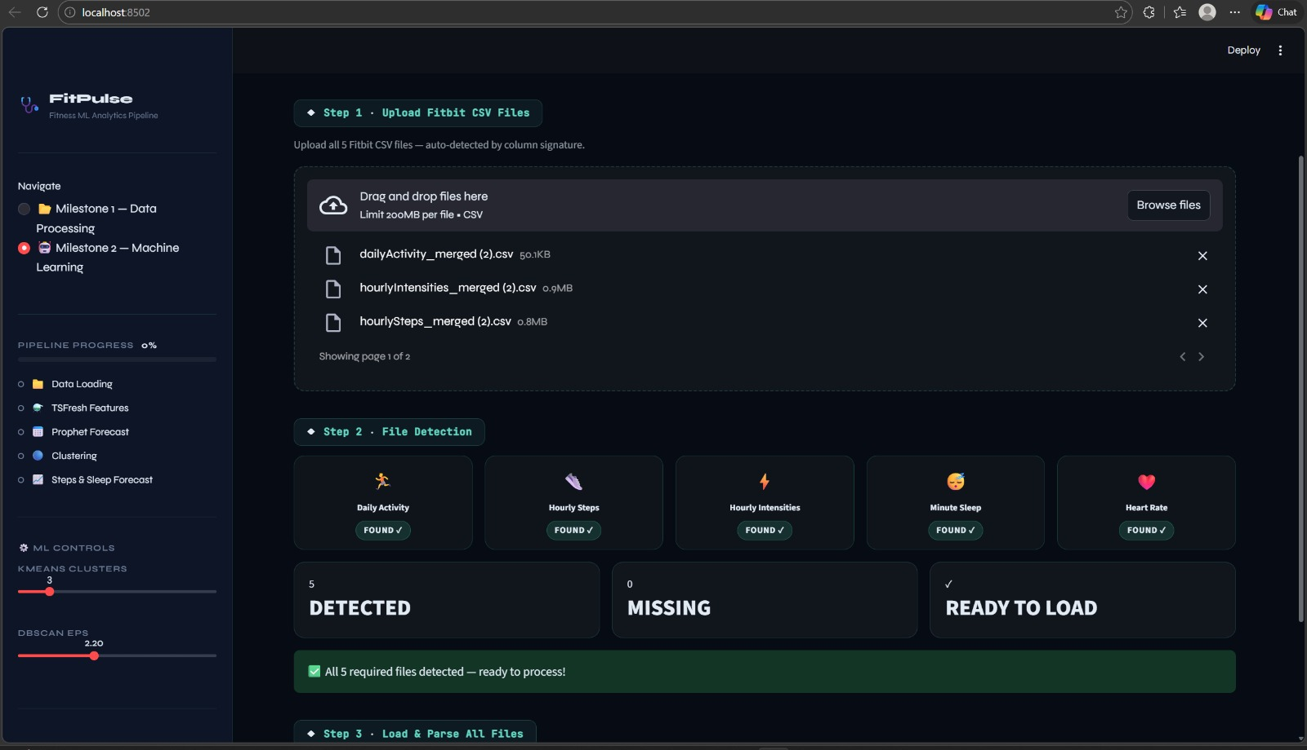
Pattern Extraction - Result:

Slide 28
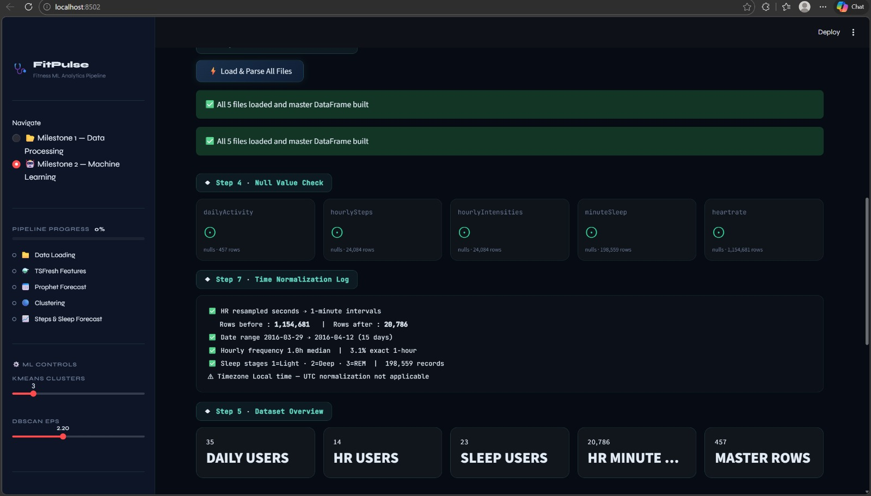
Pattern Extraction - Result:

Slide 29
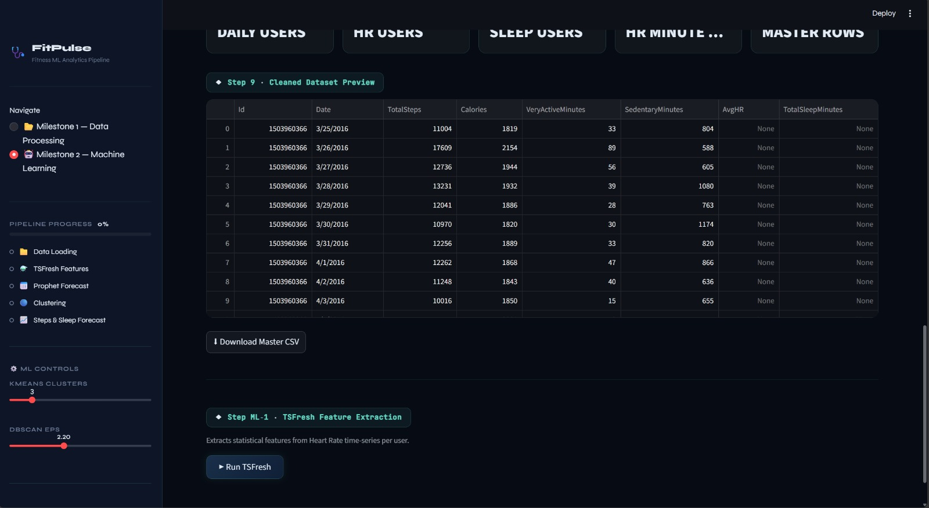
Pattern Extraction - Result:

Slide 30
Pattern Extraction - Result:

Slide 31
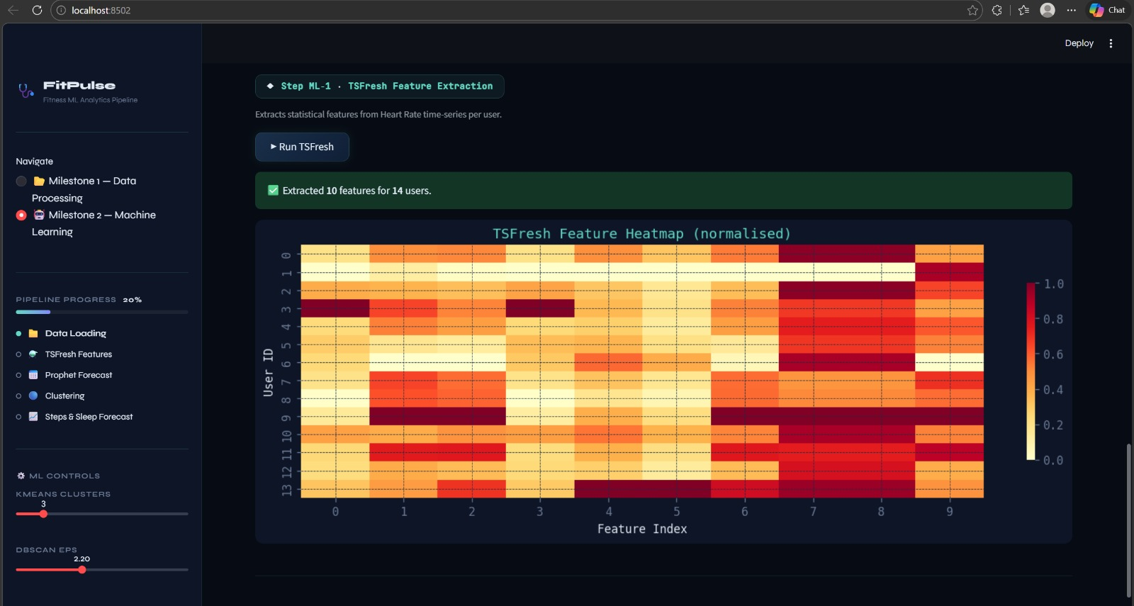
Pattern Extraction - Result:

Slide 32
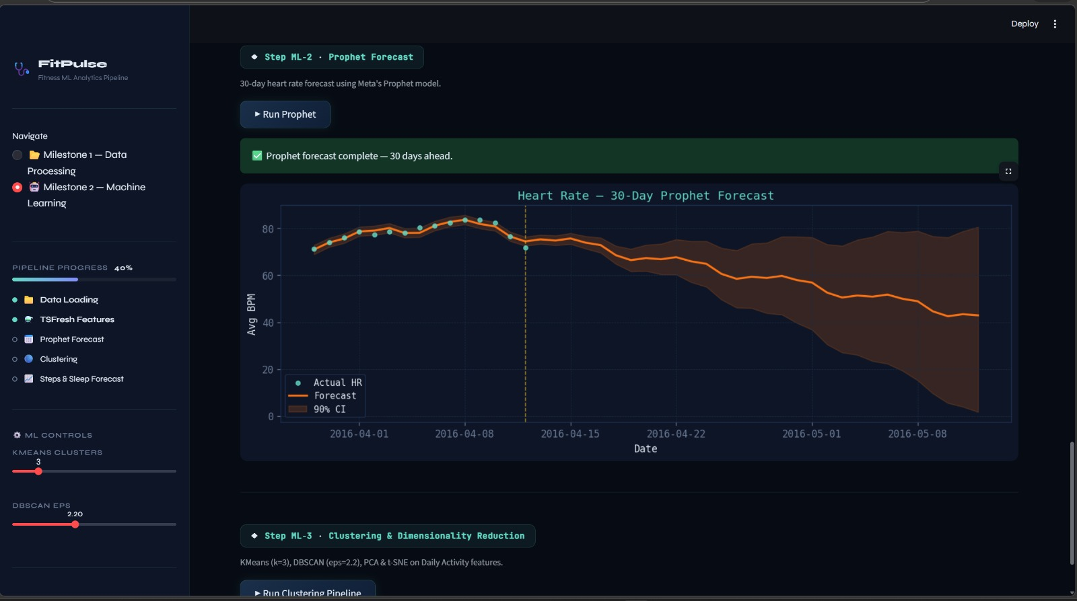
Pattern Extraction - Result:

Slide 33
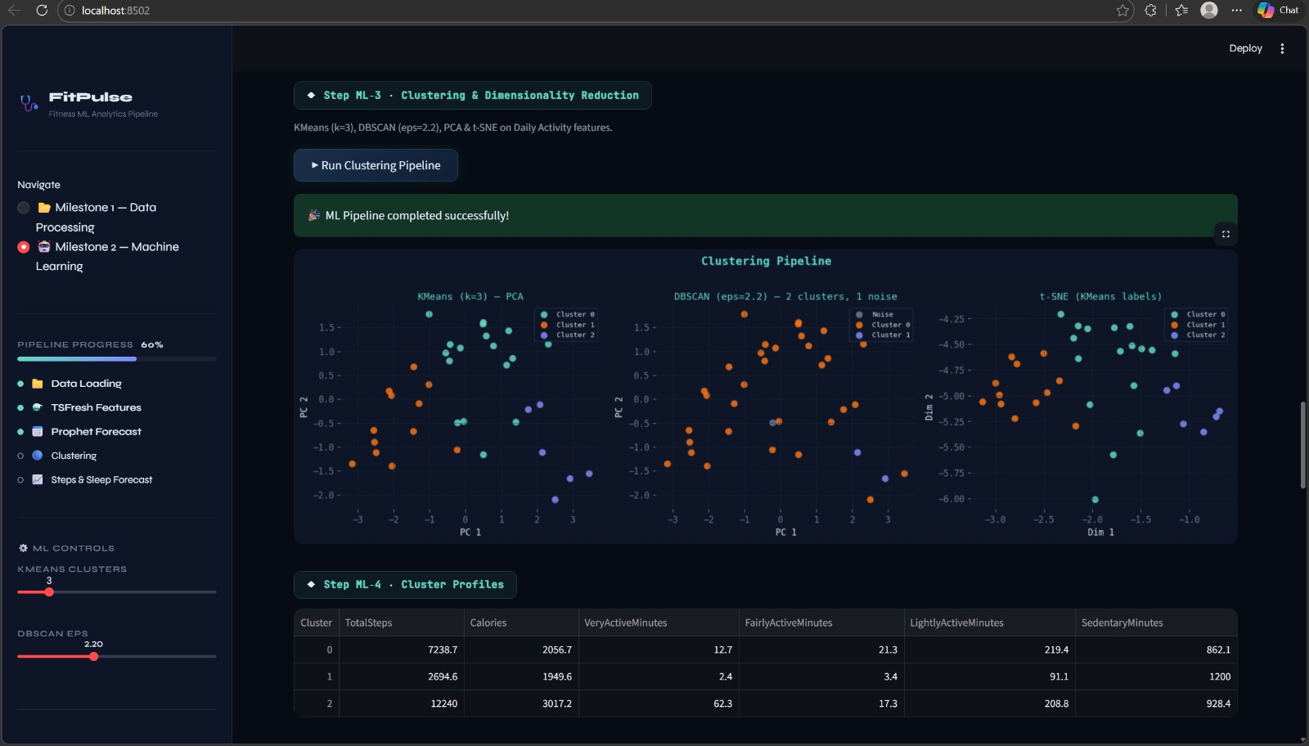
Pattern Extraction - Result:

Slide 34
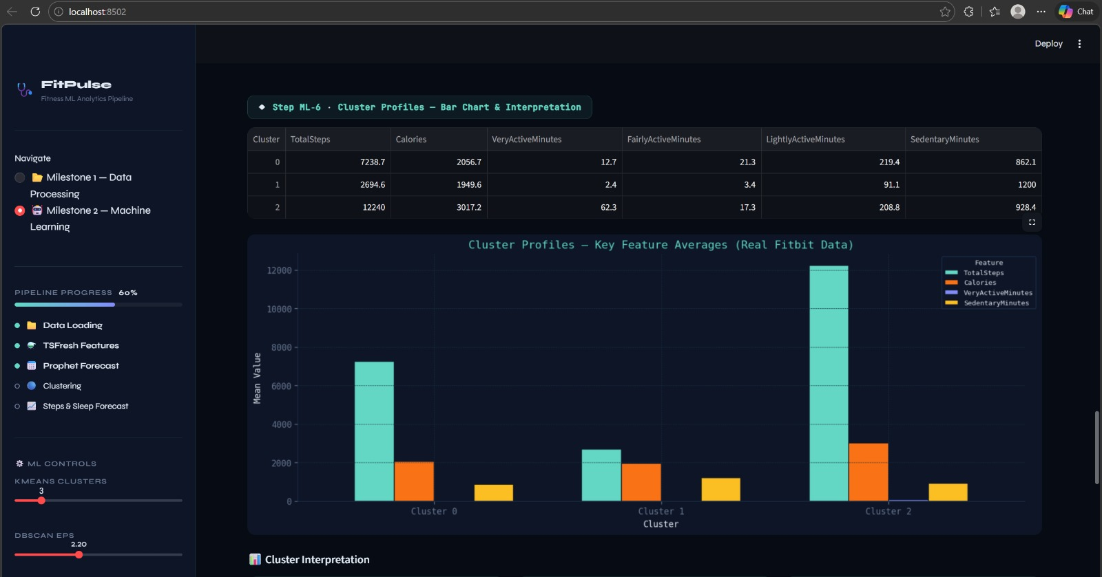
Pattern Extraction - Result:

Slide 35
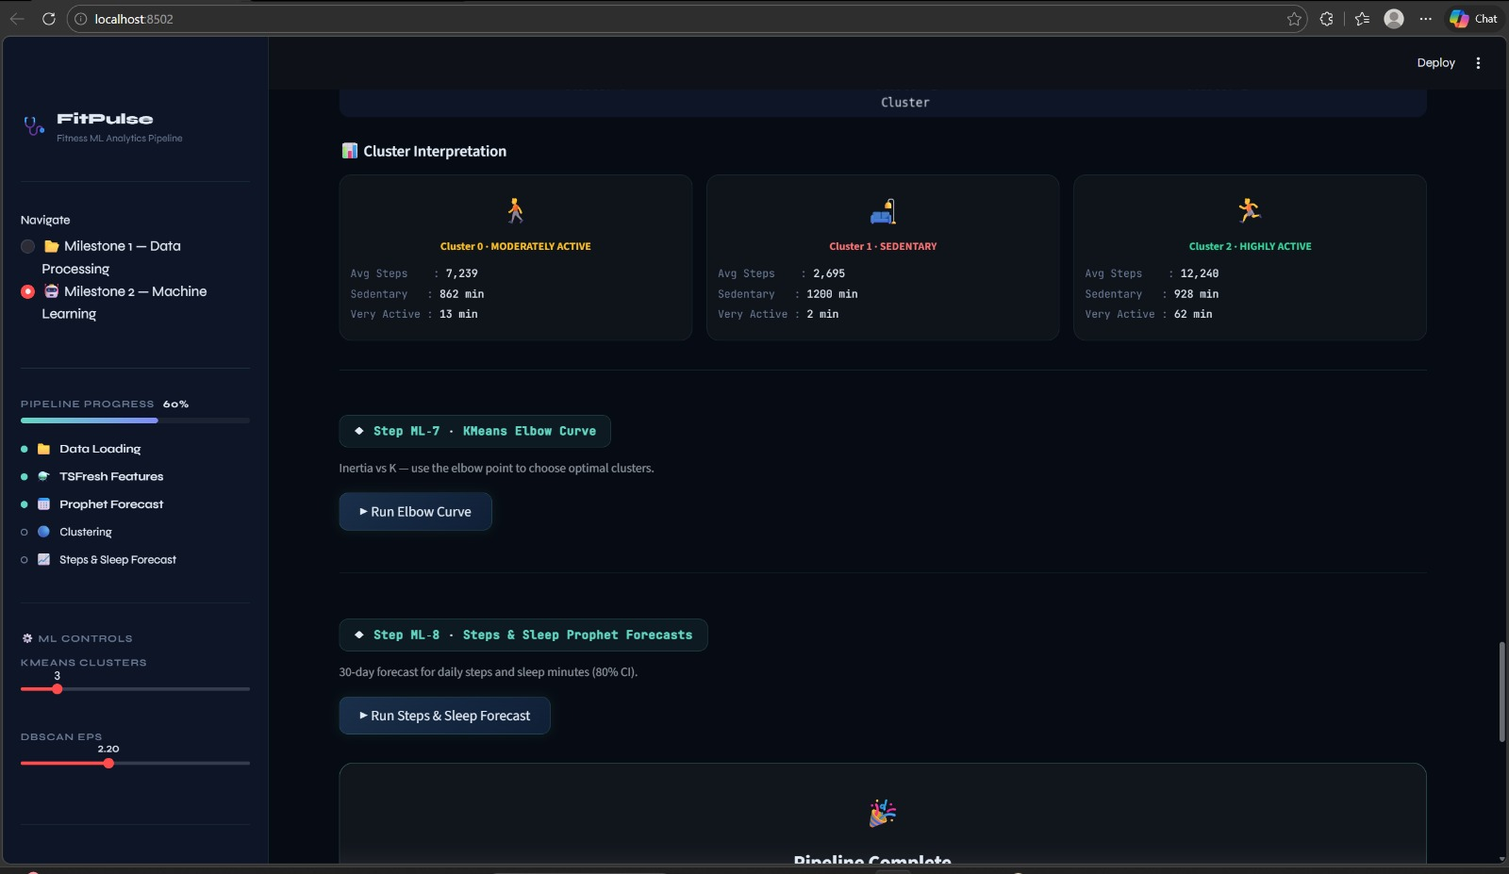
Pattern Extraction - Result:

Slide 36
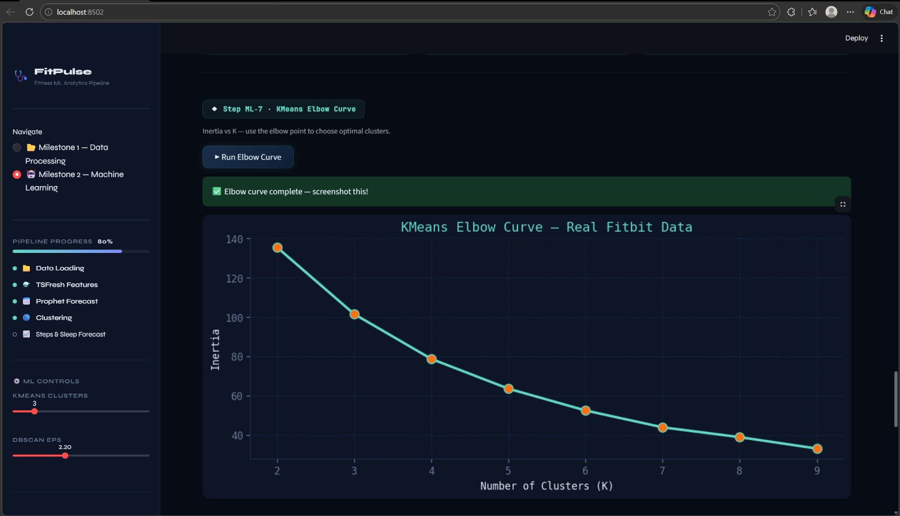
Pattern Extraction - Result:

Slide 37
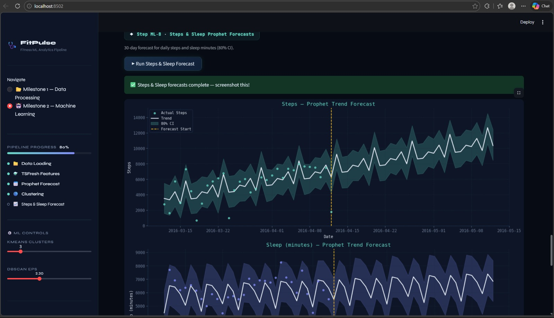
Pattern Extraction - Result:

Slide 38
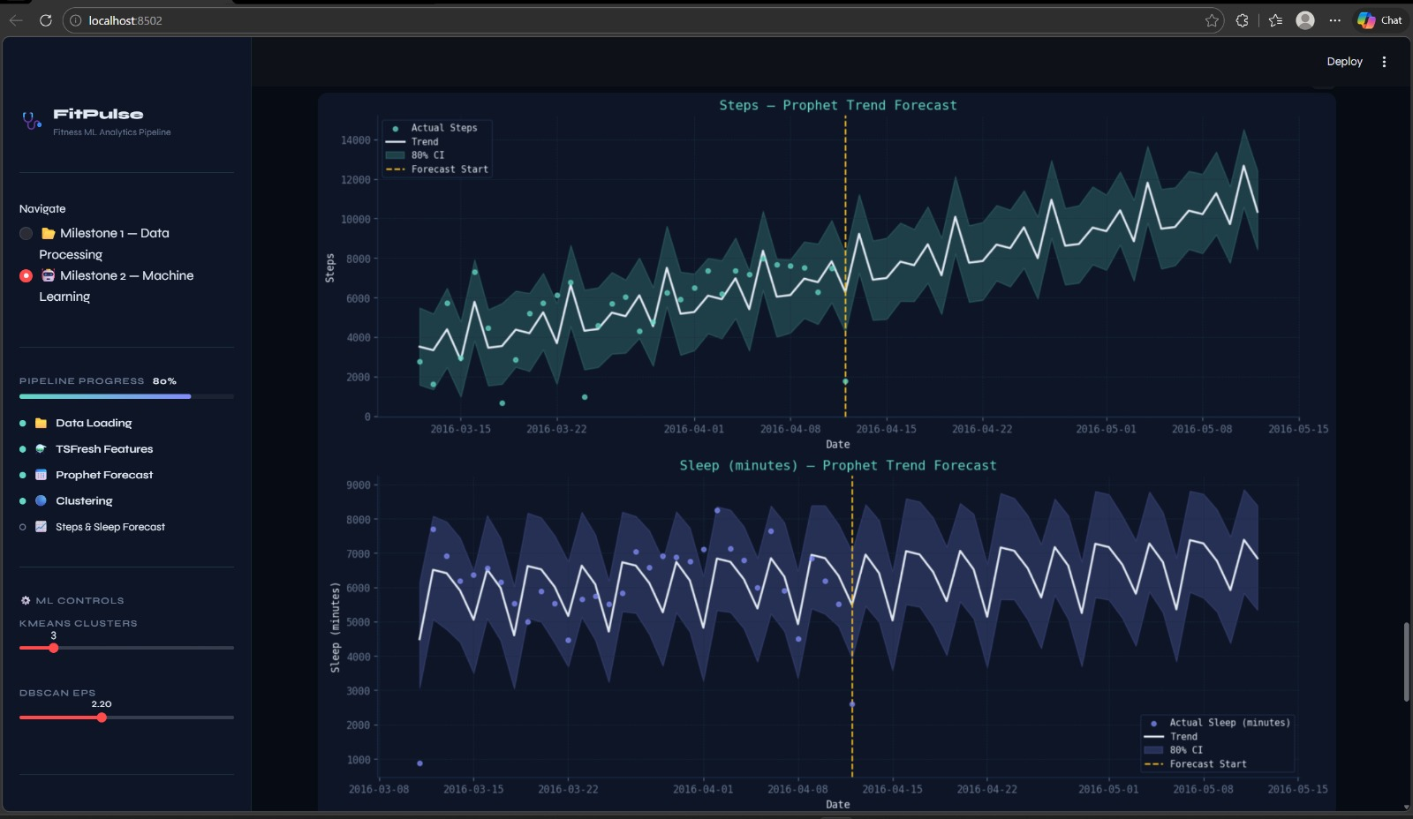
Pattern Extraction - Result:

Slide 39
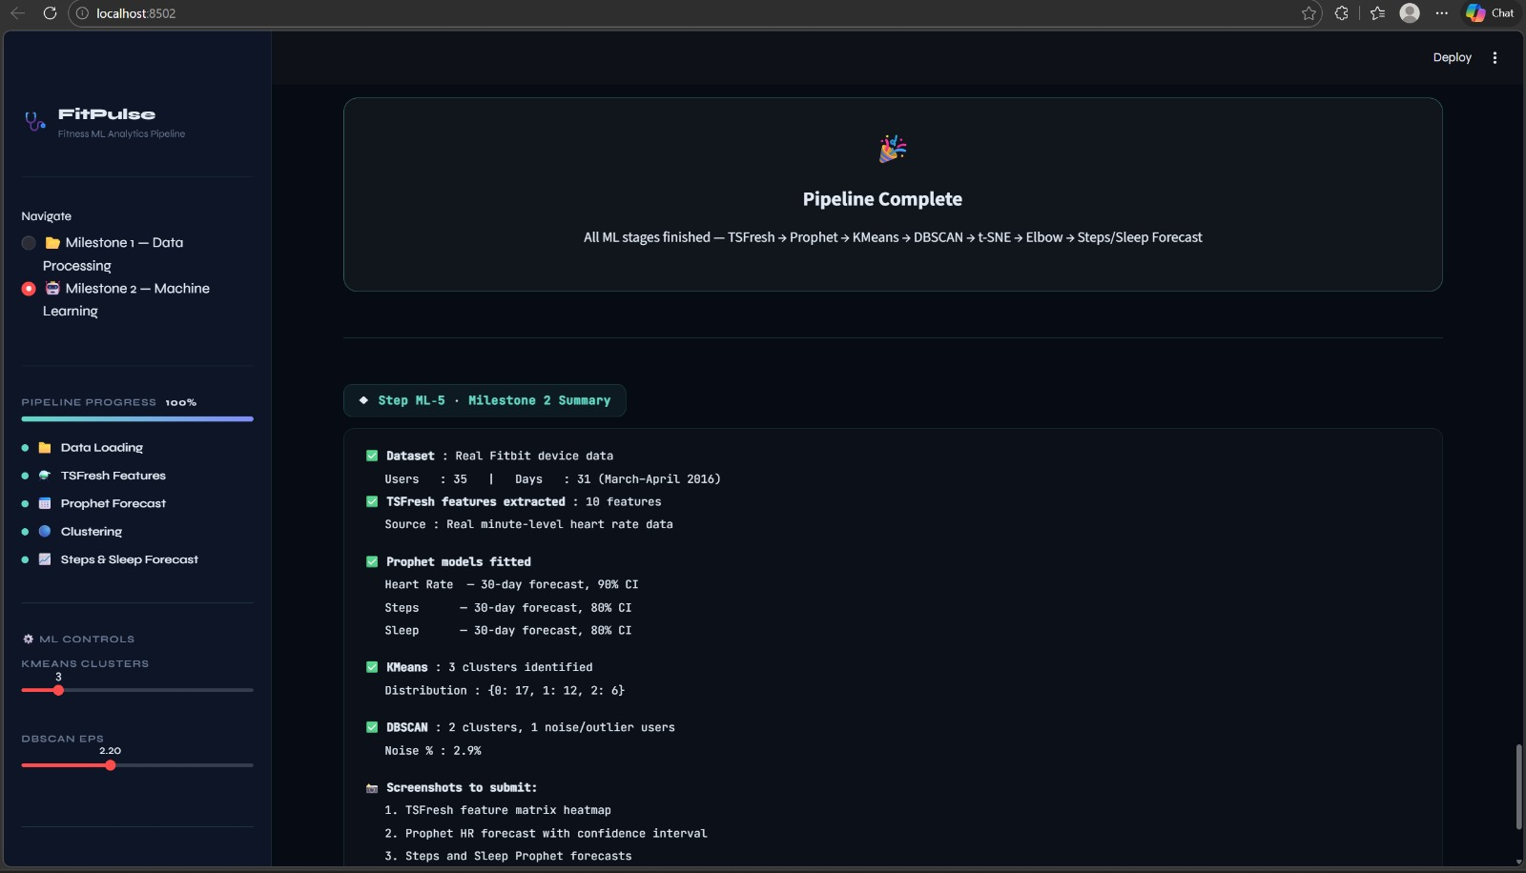
Pattern Extraction - Result:

Slide 40
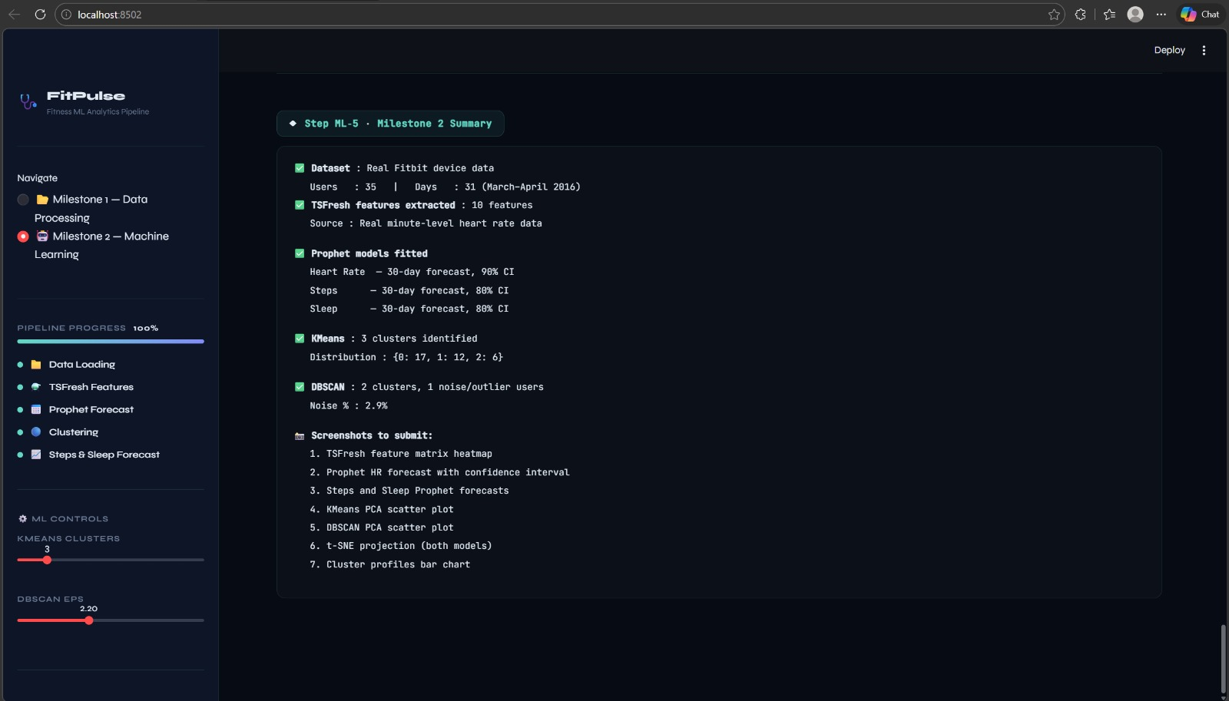
Pattern Extraction - Result:

Slide 41
THANK YOU
FitPulse Analytics • ML Pipeline • Satindra Kumar B S

